Slide 1



Slide 2
Copy URL into browser to play intro video
https://cognizant.kpoint.com/app/video/gcc-2b27e004-2e07-4bbb-bf70-674475c7cbc2

Slide 3


Go-Live: 16th January, 2018
One Stop Portal for all Learning Needs
From ELT to ELT
CAMPUS HIRE
SKILLING
YEAR 1 LEARNING
LEADERSHIP DEVELOPMENT
COGNIZANT CAREER ARCHITECTURE
MERGERS & ACQUISITIONS
ONBOARDING LATERAL
SALES EXCELLENCE
Notes:
Cognizant Academy is a partner to the associates right from the Campus Hire stage to their growth through CCA, all the way upto Leadership Development. It also supports onboarding of Laterals, M&A, Sales Excellence training and Skilling needs of various Business Units as and when the need arises.
Whether it is a campus hire, a veteran Practice Lead, an Instructor, or a Delivery Head who is looking for quick skilling, Cognizant LEARN will play a central part in their experience.

Slide 4
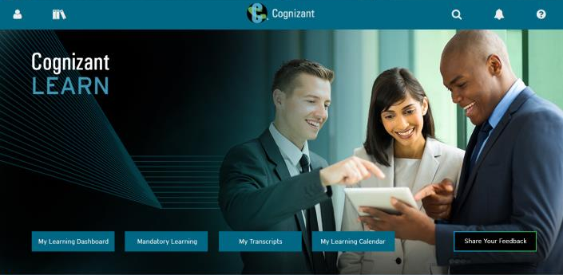








Here’s what Cognizant LEARN has to offer
Personalized Learning Paths
Learner Dashboard
Cloud Deployed
Collaborative Learning Ecosystem
Single-click
access to
information
and actions
Intuitive navigation and workflows
Mobile and Social capabilities
Enterprise Search
Accessible
anywhere
Robust
reporting
and analytics
Seamless Integration
Multi
Lingual
Notes:
Here’s what Cognizant LEARN has to offer:
Personalized Learning Paths
Empowers associates with tools that connect learning to critical developmental and performance needs. Equips our associates with their own curated content aligned to their role development plans (RDPs).
Learner Dashboard
Visual timelines of priorities and tasks and individualized insights into learning progress that help associates track their role readiness and RDP completion progress.
Cloud Deployed
Hosted in high resilience cloud environment, the platform gives our associates responsive access from anywhere around the world through office network or through internet.
Collaborative Learning Ecosystem
Empowers informal learning by providing learners a complete set of tools and communities of practice to collaborate with and to share knowledge around any topic or activity. Provides social platform for agile creation of content by subject matter experts.

Slide 5
What's changing for you?
1
One stop portal for all your learning needs. Access to RDP app / My learning and ELM through Cognizant LEARN
2
Proactive search replacing Monthly Calendar
3
Attending WebEx sessions is simplified with no separate need of WebEx Links and User ID / Password
Registration from Cognizant LEARN prior to start time of session
Launch session directly from Cognizant LEARN
4
Register and launch Virtual classroom and Classroom sessions through Cognizant LEARN. Single sign on User ID / Password will be enough to log in
5
Get learning credits for only completed learning activities. (Self-reported training or facilitating training excluded)
Notes:
Based on what you have experienced in ELM , these are the key changes you would experience in New LMS Cognizant. Cognizant LEARN powered by Sum total – is an enterprise LMS that has features based the industry follows.
What's changing for the associates? –
1.you all were going through various portals, and now its just 1 stop portal for all your needs. Be it RDP or Mylearning . Cognizant LEARN will have everything.
2. All these while associates used to get the learnings scheduled over email as – Monthly learning calendar. Now associates could search proactively from Cognizant LEARN. Monthly calendar will not be published henceforth.
3. Attending Webex session simplified. No separate links / user ID / PWD is required, however, registration in Cognizant LEARN prior to start time of session is required. One could forward the calendar invitation to others but however, one would have to register in Cognizant LEARN prior to start of the session.
5. Learning credits to be awarded only for Completed learning activities. No Learning credits to be awarded for Self-reported training or facilitating training (Honorarium process will continue).

Slide 6
What's changing for you?
Assessment & RDP
1
Maximum of 3 attempts ONLY will be supported for a particular assessment irrespective of tenure in Cognizant
2
RDP submission process and certificate timeline selection discontinued; RDP will be generated as soon as criteria is met
3
RDP refreshers every 4 hours.
4
No visual view of “Equivalent courses” available in RDP. On completion, other equivalent courses will be marked as completed
Notes:
1. 3 attempts- Policy and process change to have only 3 attempts of any particular assessment
2. No RDP Submission process or certificate timeline selection. RDP will be generated when learner meets the criteria and recommended sequence/dates of certificates will be provided. RDP generation will happen once criteria is met.

Slide 7
Maximum – 3 attempts for an assessment
Key points:
Maximum 3 attempts for a particular assessment for the whole tenure in Cognizant.
Gap between each attempts is set as 10 calendar days.
Remaining attempts will be clearly visible to the associate while registering
Associates will see available attempts for their respective assessment in Cognizant LEARN system.
Let’s take an example:
For Eg: Core Java for the assessment CCJP assessment
Associate attempted the assessment 2 times in the whole of his/ her tenure in Cognizant. Only 1 attempt will be available.
Associate had taken all 3 attempts and not cleared the assessment. He / She will have Zero (0) attempts. In the system it will show as -No. of attempts – 0
RDP will not be complete.
What next?
Associate could take up another skill / assessment to make the RDP complete.
Why this change?
Associate is accountable to complete the learning and assessment. Associates will have to get prepared adequately to complete the assessment and move forward.
Not applicable for : External Certifications, Brain bench assessments, GTP assessments, L2 assessments and Mock assessments have been excluded from this change of max 3 attempts and gap between attempts.
Notes:
1. 3 attempts- Policy and process change to have only 3 attempts of any particular assessment
2. No RDP Submission process or certificate timeline selection. RDP will be generated when learner meets the criteria and recommended sequence/dates of certificates will be provided. RDP generation will happen once criteria is met.

Slide 8
What's changing for you?
CDO Specific Changes*
1
Role Exit Criteria to be renamed as Role Development Plan with a new User Interface in Cognizant LEARN
2
Complete skill profiling in My Career App to view RDP
*Along with all other changes
Notes:
CDO – Moving to RDP from REC. One needs to complete skill profiling in my career app to view in RDP.

Slide 9
What's changing for you?
Onsite Associates*
Learners can register and select slot for Skill Based Assessments on Cognizant LEARN. No manual e-survey to capture nominations.
*Along with all other changes

Slide 10
What more…
Vendor based online courses
Launch Skillsoft courses from Cognizant LEARN to get completion marked
Launch Skillsoft Books and Videos from Cognizant LEARN. Completion NOT tracked
Launch Pluralsight courses from Cognizant LEARN and completion marked. Completion marking within 48 hours
Brain bench assessments will be non-proctored. Launch the assessment anytime from Cognizant LEARN. Completion marking within 48 hours
Notes:
With respective to Vendor based online courses, a few changes.
Skill soft – all courses , books and videos are available from LMS. Courses will be marked for completion. However video and books are not yet catalogued in the system yet. They are good to read and reference , however learning credits will not be assigned for Books and videos.

Slide 11
What more…
Online courses can be rated with five star rating
On completion, online courses can be reviewed and re-launched without registering again
On-Demand Labs available for defined images – learner can register and reserve lab for a defined period of time

Slide 12
Important dates to note
10th January, 2018
Complete all online learning that is in progress.
Unfinished learning will not be carried forward to the new platform.
11th January (5:00 AM IST | 12:30 AM CET | 10th January – 3:30 PM PST) to 15th January, 2018
ELM shutdown for migration and cutover to Cognizant LEARN
16th January, 2018
Cognizant LEARN to Go Live.
All learning except assessments will resume
22nd January, 2018
Assessments and all modes of learning resume.

Slide 13

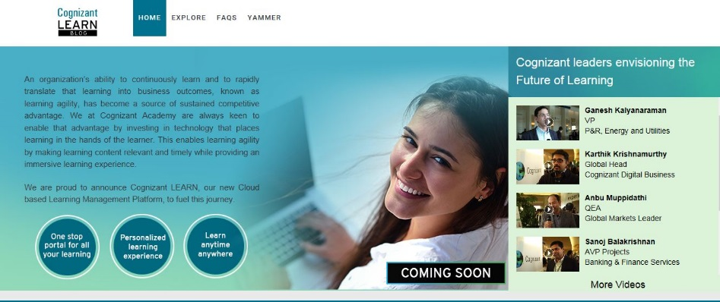


Personalized Communication
Announcements, updates and learning resources
From the FutureOfLearning2@cognizant.com mailbox
Cognizant LEARN Blog
https://blogs.cognizant.com/cognizantlearn/
Info / Updates / FAQs / How To Videos
Cognizant LEARN Yammer Page
Info / Updates
Click Here to Visit

